Slide 1

Sprint 3

Slide 2

Sprint goals
- Network drawing
- Roles/Documentation
- Terraform script
- Website wireframe

Slide 3
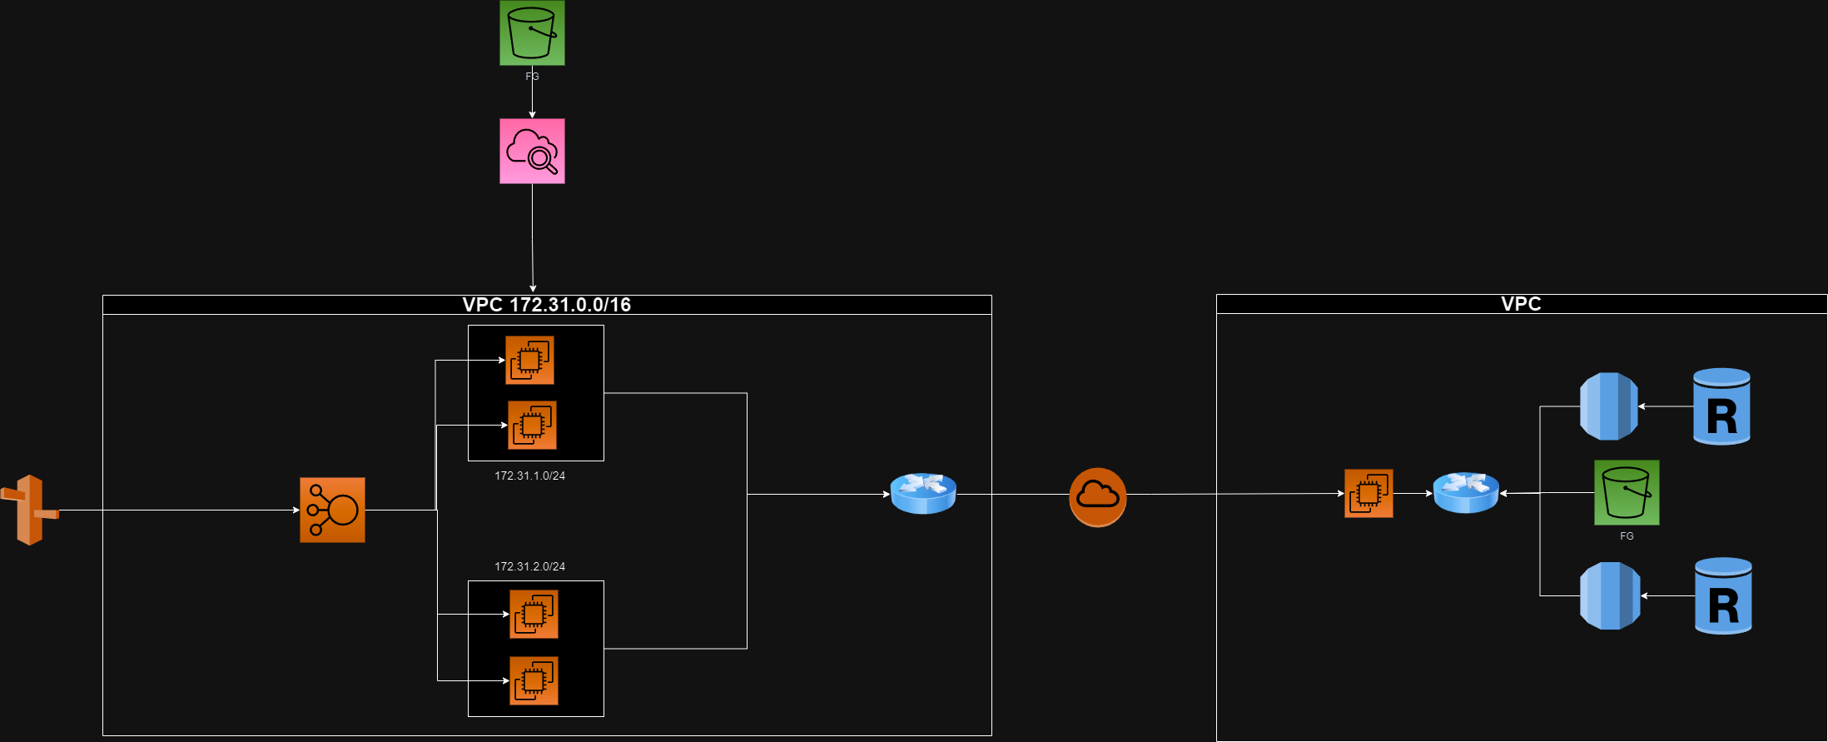
Network drawing

Slide 4
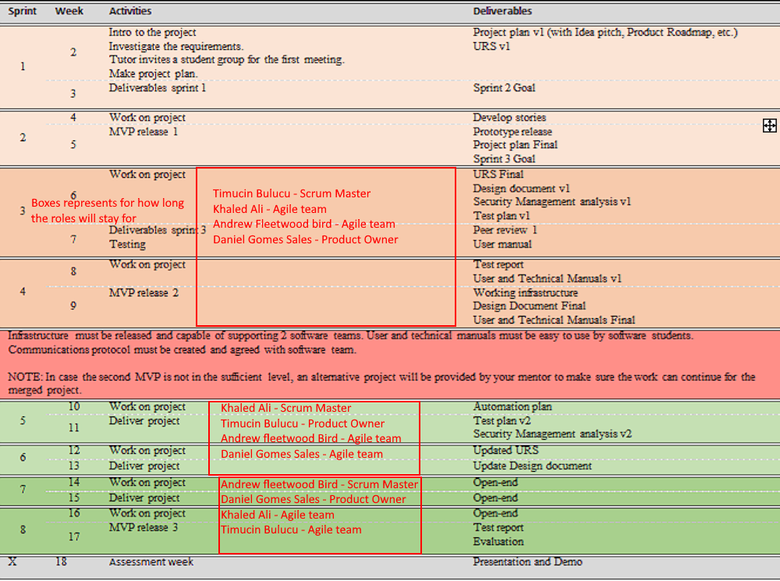
Roles/Documentation
We rotate our roles bi-weekly. The schedule is as follows
Currently we’ve brought our design document/project plan up to speed for this sprint

Slide 5

Terraform script demo

Slide 6

Website wireframe demo

